Slide 1
Problem Structuring and Modelling
Emergency Department
messy problem → model → decision

Slide 2
Session Plan
Messy situation
↓
Structure the problem
↓
Build a model
↓
Test ideas
↓
Make a decision

Slide 3
Very brief intro to “Soft OR”
Soft OR
Analytical Thinking
Presentational skill
Toolkit of approaches*
*Further reading:
- Strategic Options Development and Analysis (Eden et al.)
- Soft Systems Methodology (Pidd et al.)

Slide 4
Examples – Rich Picture

Slide 5
Working with groups
Planning
Facilitation
Goal setting
Follow-up
Ownership and stakeholders
Purpose
Agenda
Managing input
Writing up
Following up
Active listening
Monitoring impact
… and behaviour

Slide 6
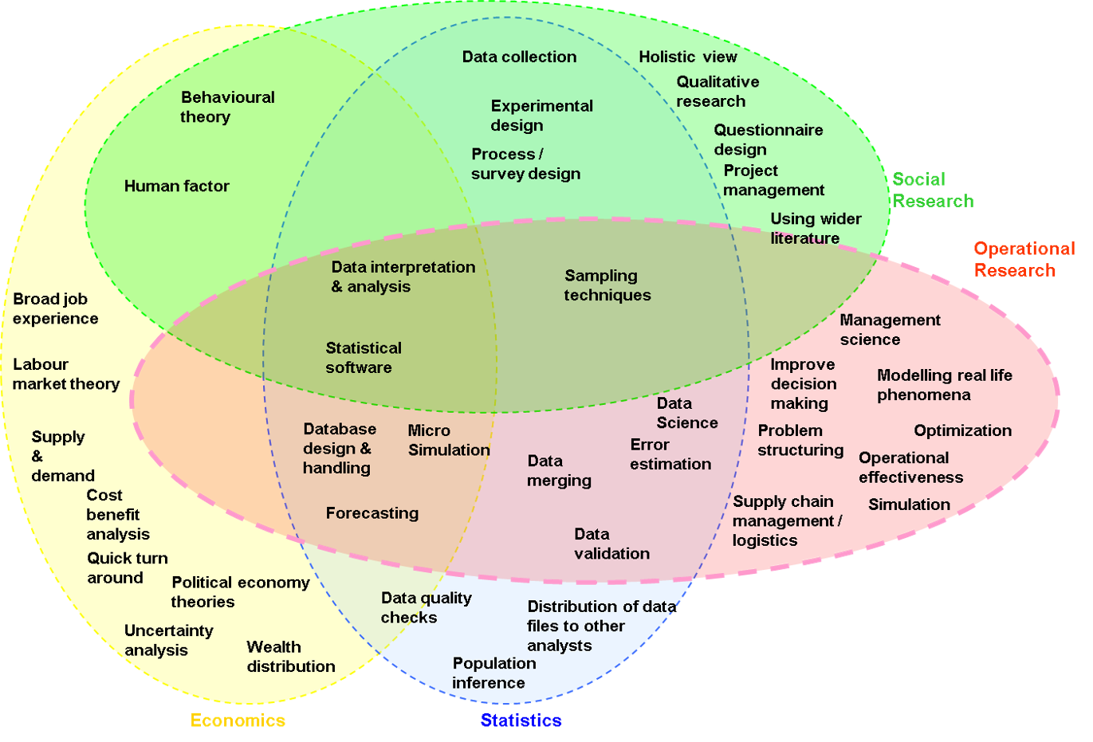
Stuff you already know!
Option | Cost | Impact | Deliverability
Option 1 | £ | !!!!! | Amber
Option 2 | ££ | !!!!!!!!!! | Green
Option 3 | £££ | !!! | Red

Slide 7
To structure a problem you must…
Define the problem
Involve people
Generate an outcome
Analytical questions
Embrace the complexity
Problem “owner” always involved and usually others as well
Be practical
Relevant factors
Explore and eliminate ambiguity
Consider data/evidence needed and how to obtain it
Address the whole problem
Add a useful structure
No “magic wands”
Context
What are the risks? Will it work?
Give appropriate value to knowledge and opinion
Clearly specify the analysis and data required
Be sparing with the call on their time
Ensure shared understanding of the issues
Write it up in an understandable format

Slide 8
Your task today
1. Read and discuss your assigned problem within your group
2. Produce a problem structure for it using suitable methods…
  You should consider:
  What are the relevant analytical questions?
  What factors do we need to know about to answer them?
  Are there any relationships between these factors?
  What analysis would you carry out throw light on the problem?
  What data is required and how will you obtain it?
  What are the risks for your approach and how will you mitigate them?
3. Present your proposed approach back to the wider group
4. You will need to manage your time!

Slide 9
Rules
Think first
Predict before seeing results
No “right” model at the start

Slide 10
Scenario
A hospital is reviewing staffing levels in its Emergency Department (ED).
Recently:
Waiting times have increased
Staff feel under pressure
Managers are concerned about costs
Patients arrive throughout the day needing treatment. Some cases are quick to resolve, while others require more time and attention.
The department is staffed by a team of doctors and nurses. Staff work together to assess and treat patients.
Hospital management want to understand:
What changes might improve performance while controlling cost.
They are open to analysis but are not yet sure what kind of modelling or data is needed.
You have been asked to investigate.

Slide 11
Part A
Problem Structuring

Slide 12
Part A
Worksheet Part A
In groups discuss:
What decisions might be made?
What would we need to know?
Sketch the system
Time: 20 minutes

Slide 13
Share back
Share what we have found from Part A
Time: 10 minutes

Slide 14
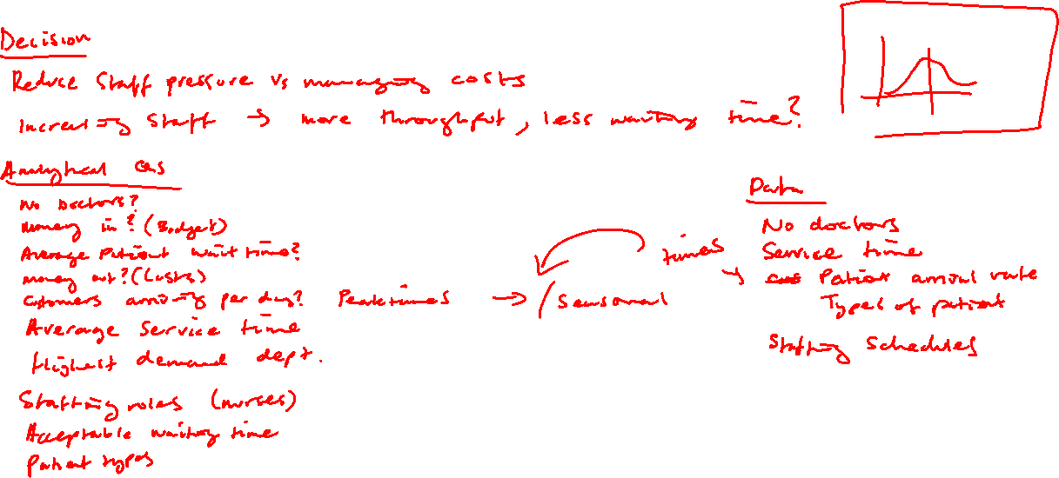

Slide 15
Part B
Prediction

Slide 16
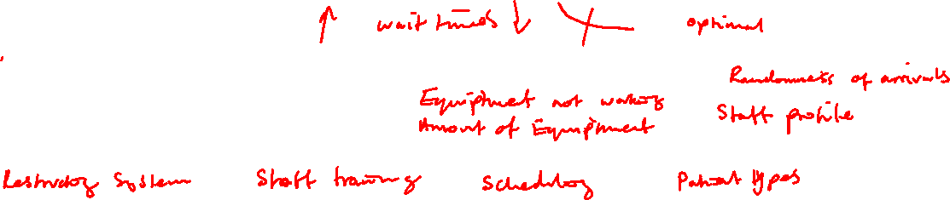
Prediction Phase
Worksheet Part B
In groups discuss:
What happens if staffing increases?
What might still cause delays?
What kinds of changes might improve the system?
Time: 10 minutes

Slide 17
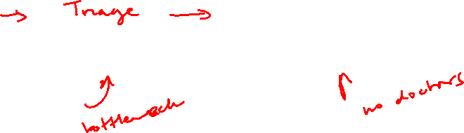
Conceptual Thinking
Arrivals → ? → Treatment → Exit
What might happen between arrival and treatment?

Slide 18
Part C
Building the Model

Slide 19
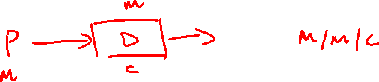
First Model

Slide 20
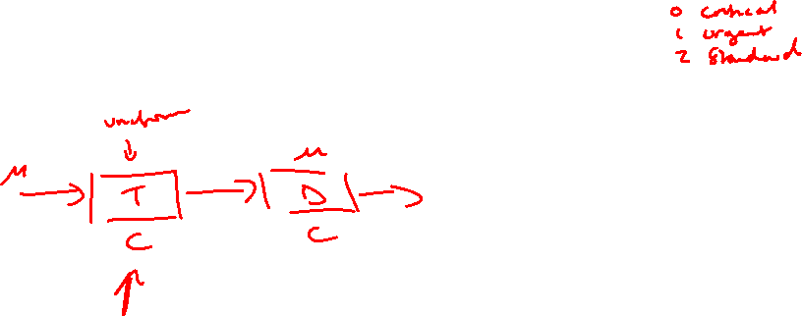
Add Triage
Gather more information about a patient?

Slide 21
Variation
Some cases take longer than others
Add variability.
Patient Types!
critical
urgent
standard

Slide 22
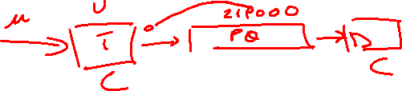
Fairness
Should everyone be treated strictly in arrival order?
Add in priority queue

Slide 23
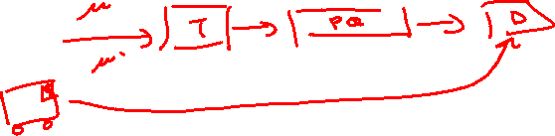
Extreme Case
What if something very serious arrives during treatment?
Add in pre-emption
Should anyone skip triage?

Slide 24
Major thing that we haven’t modelled
Cost
We would require cost to do any serious analysis!

Slide 25
Part D
Results

Slide 26
What is the optimal number of doctors?
Define optimal:
minimise critical breaches
keep urgent breaches low
avoid excessive cost
maintain reasonable utilisation
You already have the data from the simulation. For each doctor level:
critical breaches
urgent breaches
standard breaches
utilisation
So, the decision rule becomes something like:
Choose the smallest number of doctors that keeps critical breaches ≈ 0 and urgent breaches acceptable.

Slide 27
Results from Simulation
You can access the full simulation that we have just built on the module.
Use this to fill out Part D and work out how many doctors are acceptable.
Also consider what costs would be needed for this simulation to be more reaslistic!

